Slide 1
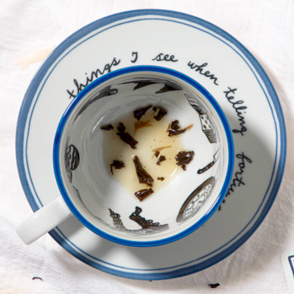
Reading Tea Leaves
2022 Rho Chi Lecture Award Address
Jean Nappi, Pharm D
Professor Emeritus
Medical University of South Carolina

Slide 2
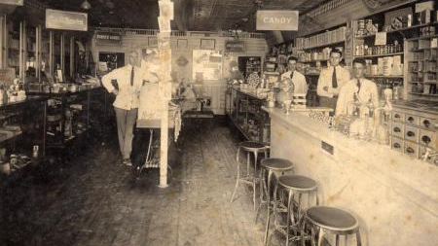
Pharmacy Circa 1922

Slide 3
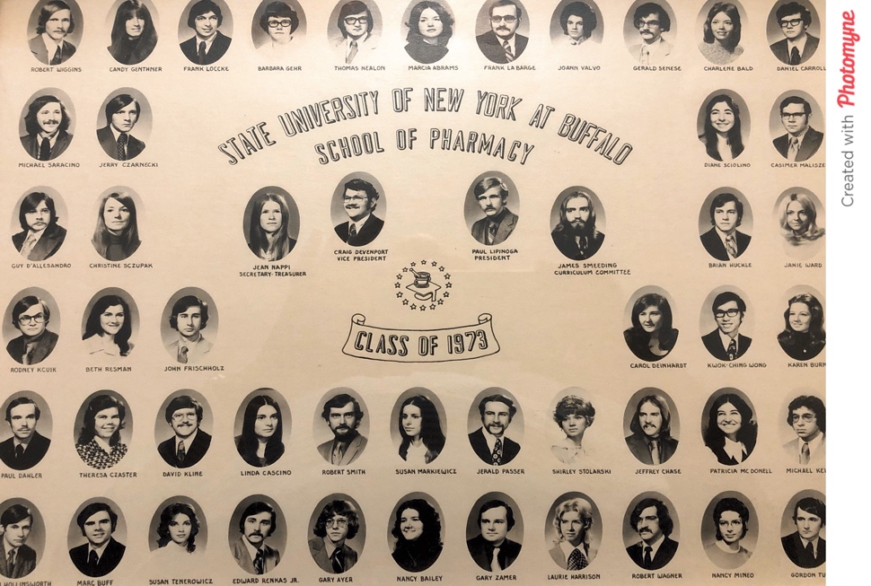

Slide 4
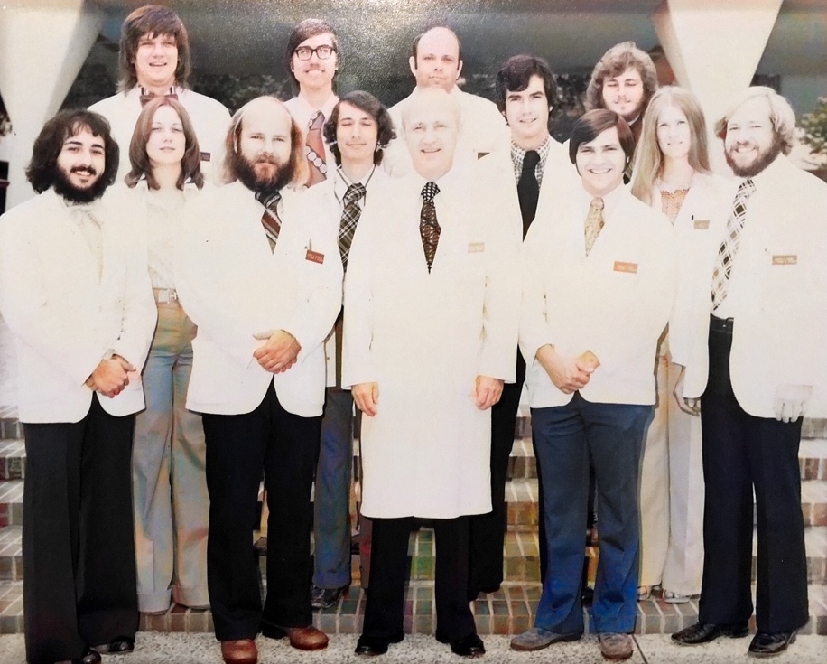
University of Texas Health Science Center at San Antonio July 1974

Slide 6
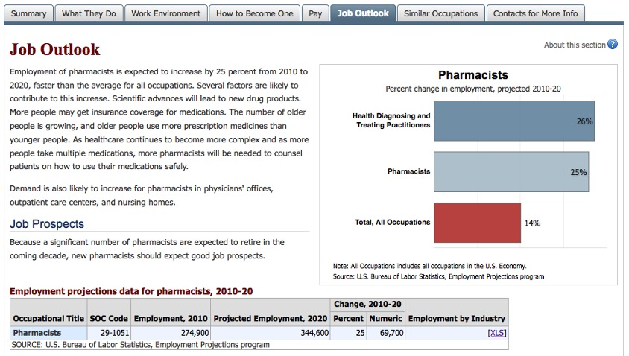

Slide 9
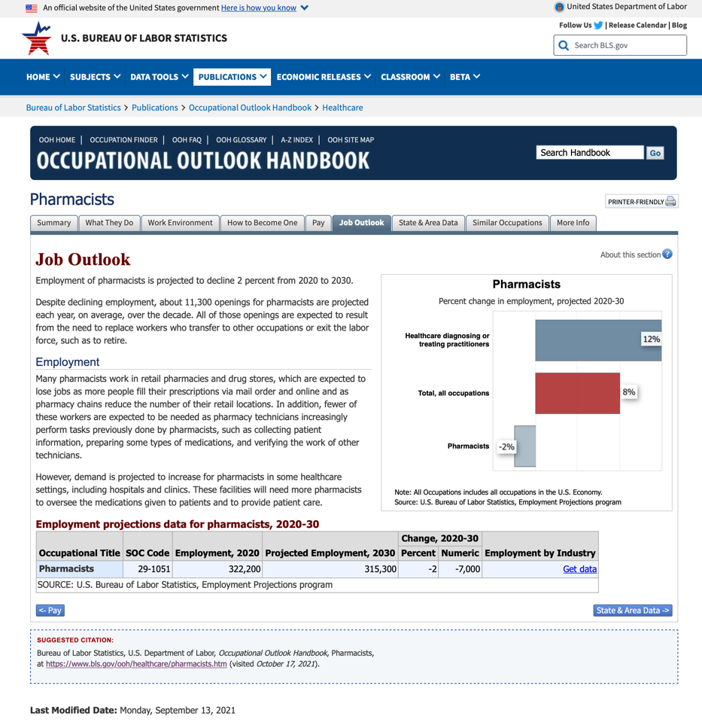

Slide 10
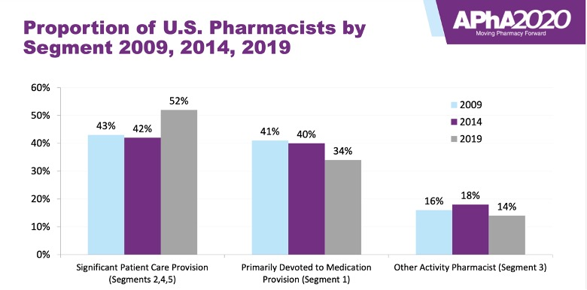

Slide 11
Thank you
Philip Hall
Joe DiPiro
Kathy Chessman
Bill Evans
Leigh Ann Ross
Cathy Worrall

